Slide 1
Lecture # 1 (Final) Serial Communications Interfaces

Slide 2
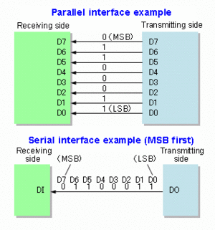
Data Transmission
Data transmission can be performed two ways.
Parallel Communications, where several bits of data are transmitted/received as a whole, on a link with several parallel channels.
Serial Communications, where data is transmitted/ received bit by bit through a single channel.

Slide 3
Serial Data Communication
Advantage of serial communication:
Smaller number of communication lines is required compared to parallel communication.
2 lines (transmit & receive) are required in asynchronous full duplex serial comm.
3 lines (transmit, receive & clock) are required in synchronous serial communication.
Disadvantage of serial communication:
More time is required to transmit/receive compared to parallel communication.

Slide 4
Types of Serial Communication
ATmega328 has 3 types of serial communication interfaces:
1. Universal Synchronous Asynchronous Receiver & Transmitter (USART).
2. Serial Peripheral Interface (SPI).
3. Two Wire Interface (TWI)/ Inter-Integrated Circuit (I2C).

Slide 5
USART vs. UART
 | UART | USART
Full Name | Universal Asynchronous Receiver/Transmitter | Universal Synchronous/Asynchronous Receiver/Transmitter
Data type and rate | It generates asynchronous data, hence has low data rate. | It generates clocked/synchronous data, hence has higher data rate.
Baud rate | Receiver need to know baud rate of the transmitter before communication to be established so that UART can generate clock internally and synchronize it with data stream with the help of transition of start bit. | Receiver need not be required to know the baud rate of the transmitter. This is derived from the clock signal and data line.
Data Structure | It uses start bit (before data word), stop bits (one or two, after data word), parity bit (even or odd) in its base format for data formatting. | USART can also generate data similar to UART. Hence USART can be used as UART but reverse is not possible.
Protocol | UART is simple protocol to generate data. | USART is complex and uses many different protocols to generate the data for transmissions.

Slide 6
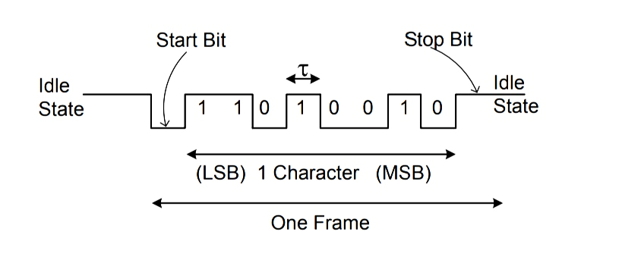
USART
It is an asynchronous serial communication.
It uses 2 pins in Port D:
1. TXD/PD1 – The serial data transmission line.
2. RXD/PD0 – The serial data reception line.
Data is transmitted/received in a serial frame as follows:

Slide 7
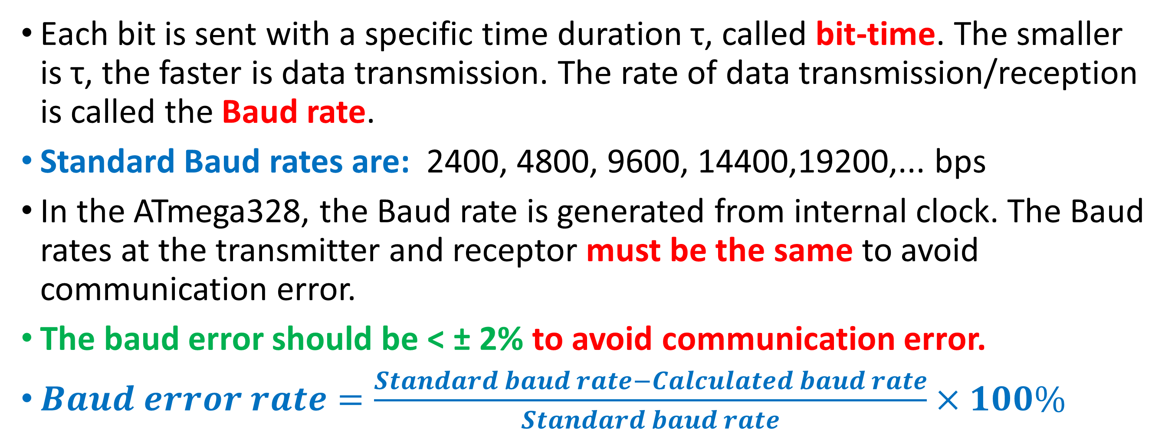
USART
Each bit is sent with a specific time duration τ, called bit-time. The smaller is τ, the faster is data transmission. The rate of data transmission/reception is called the Baud rate.
Standard Baud rates are: 2400, 4800, 9600, 14400,19200,... bps
In the ATmega328, the Baud rate is generated from internal clock. The Baud rates at the transmitter and receptor must be the same to avoid communication error.
The baud error should be < ± 2% to avoid communication error.
$Baud error rate=\frac{Standard baud rate−Calculated baud rate}{Standard baud rate}×100\%$

Slide 8
USART: Internal Clock Generation – The Baud Rate Generator
Internal clock generation is used for the asynchronous and the synchronous master modes of operation.
The USART Baud Rate Register (UBRRn) and the down-counter connected to it functions as a baud rate generator.
The down-counter, running at system oscillator clock frequency (f_{osc}), is loaded with the UBRRn value, each time the counter has counted down to zero, thus a clock is generated.
The Transmitter divides the baud rate generator clock output by 2, 8, or 16 depending on mode.
The baud rate generator output is used directly by the Receiver’s clock and data recovery units.

Slide 9
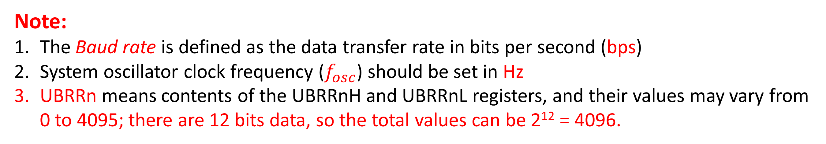
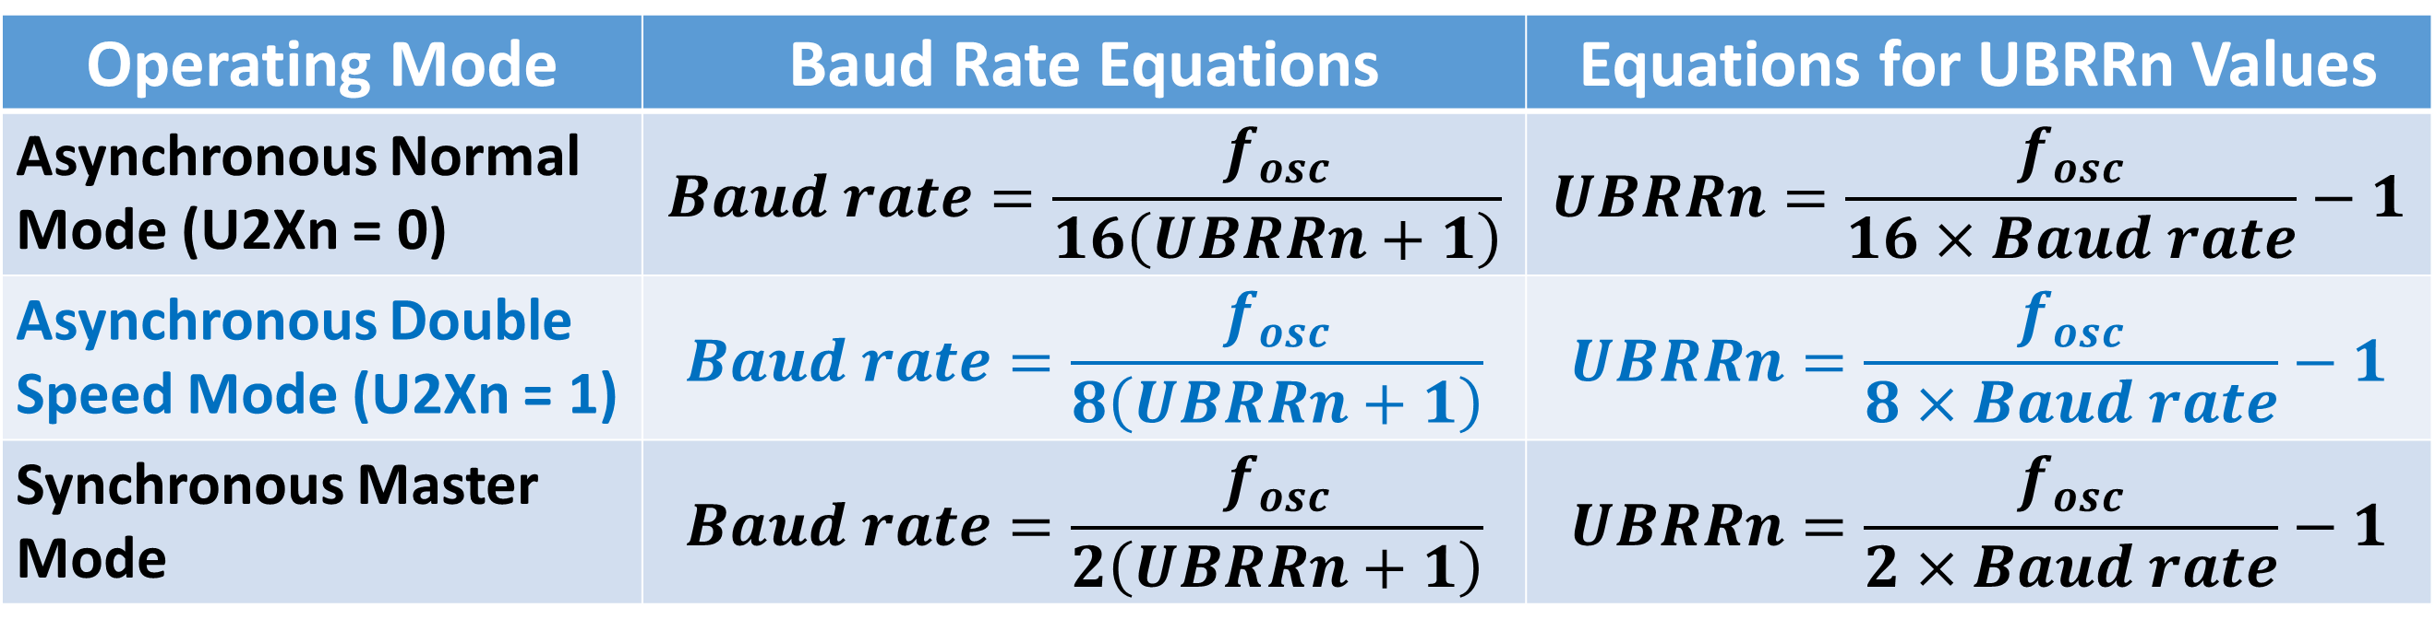
Calculation of the Baud Rate
Table 17.1 Equations to calculate Baud Rate Register Setting
Operating Mode | Baud Rate Equations | Equations for UBRRn Values
Asynchronous Normal Mode (U2Xn = 0) | $$Baud rate=\frac{f_{osc}}{16\left(UBRRn+1\right)}$$ | $$UBRRn=\frac{f_{osc}}{16×Baud rate}−1$$
Asynchronous Double Speed Mode (U2Xn = 1) | $$Baud rate=\frac{f_{osc}}{8\left(UBRRn+1\right)}$$ | $$UBRRn=\frac{f_{osc}}{8×Baud rate}−1$$
Synchronous Master Mode | $$Baud rate=\frac{f_{osc}}{2\left(UBRRn+1\right)}$$ | $$UBRRn=\frac{f_{osc}}{2×Baud rate}−1$$
Note:
The Baud rate is defined as the data transfer rate in bits per second (bps)
System oscillator clock frequency ($f_{osc}$) should be set in Hz
UBRRn means contents of the UBRRnH and UBRRnL registers, and their values may vary from 0 to 4095; there are 12 bits data, so the total values can be 2¹² = 4096.

Slide 10
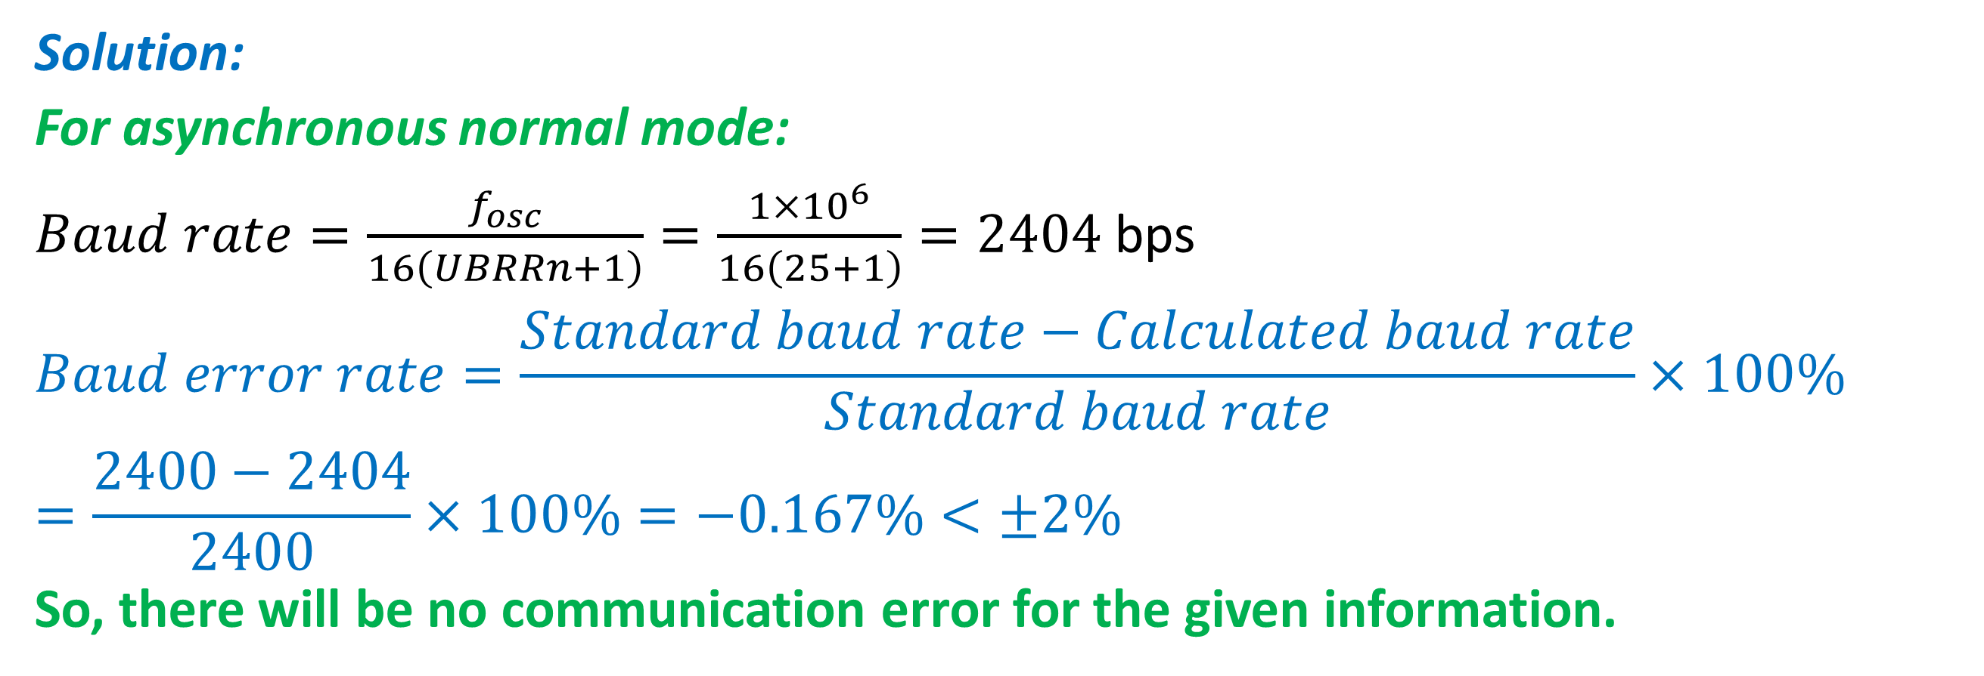
Find the baud rate for the three operating modes when f_{OSC} = 1 MHz and UBRRn = 25. Calculate the baud error and comment whether there will be any communication error or not.
Example to Practice
Solution:
For asynchronous normal mode:
$Baud rate=\frac{f_{osc}}{16\left(UBRRn+1\right)}=\frac{1×{10}^{6}}{16\left(25+1\right)}=2404$ bps
$$Baud error rate=\frac{Standard baud rate−Calculated baud rate}{Standard baud rate}×100\%=\frac{2400−2404}{2400}×100\%=−0.167\%<±2\%$$
So, there will be no communication error for the given information.

Slide 11
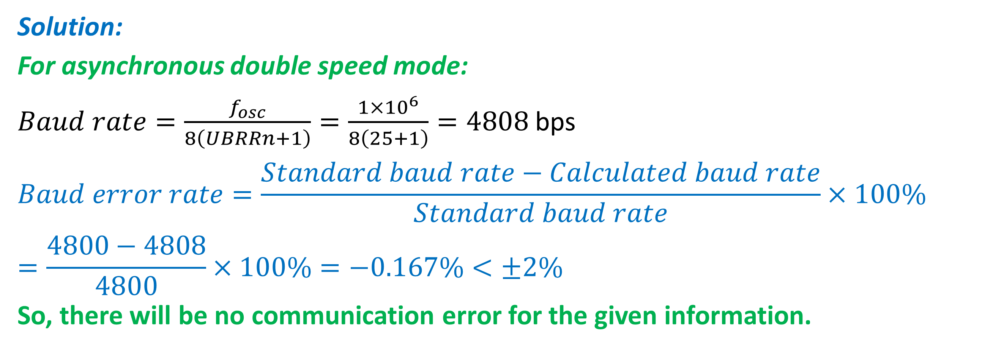
Continuation...
Solution:
For asynchronous double speed mode:
$Baud rate=\frac{f_{osc}}{8\left(UBRRn+1\right)}=\frac{1×{10}^{6}}{8\left(25+1\right)}=4808$ bps
$$Baud error rate=\frac{Standard baud rate−Calculated baud rate}{Standard baud rate}×100\%=\frac{4800−4808}{4800}×100\%=−0.167\%<±2\%$$
So, there will be no communication error for the given information.

Slide 12
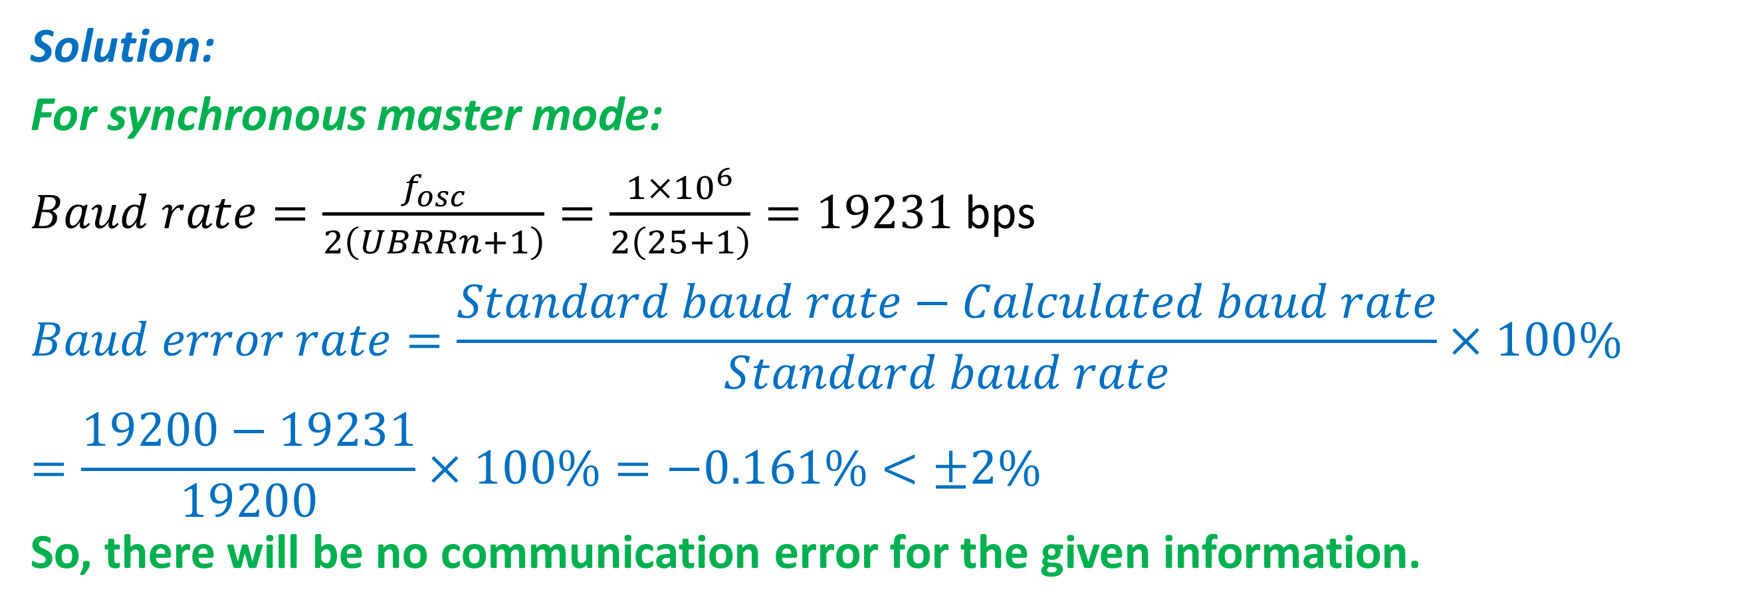
Continuation...
Solution:
For synchronous master mode:
$Baud rate=\frac{f_{osc}}{2\left(UBRRn+1\right)}=\frac{1×{10}^{6}}{2\left(25+1\right)}=19231$ bps
$$Baud error rate=\frac{Standard baud rate−Calculated baud rate}{Standard baud rate}×100\%=\frac{19200−19231}{19200}×100\%=−0.161\%<±2\%$$
So, there will be no communication error for the given information.

Slide 13
USART- Arduino Libraries
USART functions can be used with Serial Monitor of the Arduino.
1. serial.begin(baud) – to enable input/output to serial monitor with baud speed or rate in bps. Must be written in setup().
2. serial.available() – Get the number of bytes (characters) available for reading from the serial port.
3. serial.println(val) – to display val value to serial monitor with newline added.
4. serial.print(val) – as above but without newline.
5. serial.print(“Error”) – display message “Error” without newline.
6. serial.read() – Reads incoming serial data.
others functions – refer to arduino.cc.

Slide 14
USART- Arduino Libraries: Camera shutter speed example
This example detects how long a camera shutter is open by using a change interrupt. At the first transition, it gets the time and at the second one, it gets the new time. Then the main loop shows the difference.
This is tested down to a 50 µs pulse, but it could probably go a bit shorter, as it takes around 5 µs to enter and leave an ISR.
else
startTime = micros ();
started = !started; } // end of the shutter
void setup () {
Serial.begin (115200);
Serial.println ("Shutter test ...");
attachInterrupt (digitalPinToInterrupt (2), shutter, CHANGE);
} // end of the setup
void loop () {
if (endTime) {
Serial.print ("Shutter open for ");
Serial.print (endTime - startTime);
Serial.println (" microseconds.");
endTime = 0; } // end of if statement
} // end of the loop
volatile boolean started;
volatile unsigned long startTime;
volatile unsigned long endTime;
// interrupt service routine
void shutter () {
if (started)
endTime = micros ();

Slide 15
Advantages and Disadvantages of USART
Advantages
Hardware complexity is low.
As this is one to one connection between two devices, software addressing is not required.
Due to its simplicity, it is widely used in the devices having 9 pin connectors.
Disadvantages
It is suitable for communication between only two devices.
It supports fixed data rate between devices wanting to communicate otherwise data will be garbled (distorted ,unclear).

Slide 16
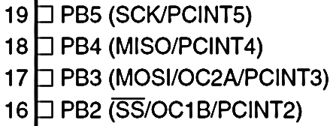
Serial Peripheral Interfaces (SPI)
SPI is a synchronous data communication.
SPI uses 4 pins in Port B:
SS/PB2 – Slave Selection pin, this pin on each peripheral enables the Master to enable and disable a slave or peripheral device.
MOSI/PB3 – Master Out Slave In, the Master line for sending data to the peripherals (Slaves), this pin enables to Master drive a slave.
MISO/PB4 – Master In Slave Out, the Slave line for sending data to the master, this pin enables the Master to receive any slave data.
SCK/PB5 – The clock pulses which synchronize data transmission generated by the Master.

Slide 17
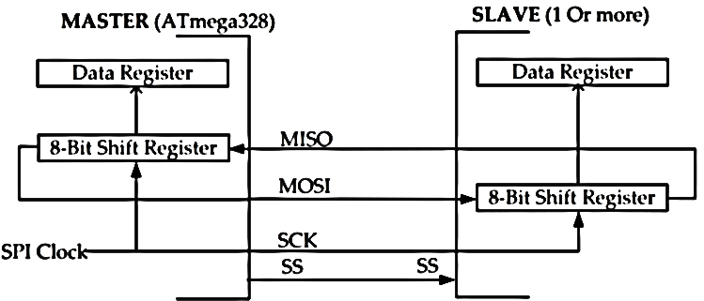
Serial Peripheral Interfaces (SPI)
Connection using SPI is in the Master-Slave configuration.
Master – Normally, is the ATmega328. Master initiates the data transfer. SPI clock is also generated by master.
Slave – Consists of 1 or more SPI I/O peripherals. The slave transfers data as a reaction to master.

Slide 18
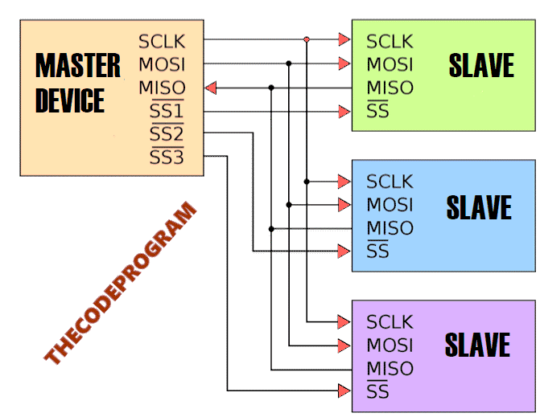
Serial Peripheral Interfaces (SPI)
Connection using SPI is in the Master-Slave configuration.
SPI Communication Schematic

Slide 19
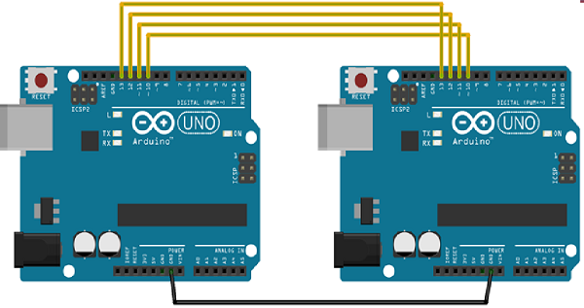
Serial Peripheral Interfaces (SPI)
Let's make an example with Arduino. In this example, we are going to let the two Arduinos to communicate with each other.
We will connect two Arduino UNO boards together; one as a master and the other as a slave.
(SS): pin 10; Slave Selection
(MOSI): pin 11
(MISO): pin 12
(SCK): pin 13
Communication
Pin connections of these two Arduinos

Slide 20
SPI Arduino Libraries
SPI.begin() – Initializes the SPI bus by setting SCK, MOSI, and SS to outputs, set SCK & MOSI low, & SS high. Must be written in setup()
SPI.end() – Disables the SPI bus.
SPI.setBitOrder(order) – Sets the order of the bits shifted out of and into the SPI bus, either LSBFIRST or MSBFIRST.
SPI.setClockDivider(divider) – Sets the SPI clock divider (SPI_CLOCK_DIVn, n = 2, 4, 8, 16, 32, 64, or 128). The default setting is SPI_CLOCK_DIV4, which sets the SPI clock to 4 MHz for Uno
SPI.setDataMode(mode) – Sets the SPI data mode: clock polarity and phase. Available modes: SPI_MODE0 – SPI_MODE3. refer to arduino.cc
SPI.transfer(val) – Transfers one byte over the SPI bus, both sending and receiving. val: the byte to send out.
Returns: the byte read from the bus.
SPI.beginTransaction(SPISettings(speedMaximum, dataOrder, dataMode)) − speedMaximum is the clock, dataOrder(MSBFIRST or LSBFIRST), dataMode(SPI_MODE0, SPI_MODE1, SPI_MODE2, or SPI_MODE3).

Slide 21
SPI Modes
We have four modes of operation in SPI as follows −
Mode 0 (the default) − Clock is normally low (CPOL = 0), and the data is sampled on the transition from low to high (leading edge) (CPHA = 0).
Mode 1 − Clock is normally low (CPOL = 0), and the data is sampled on the transition from high to low (trailing edge) (CPHA = 1).
Mode 2 − Clock is normally high (CPOL = 1), and the data is sampled on the transition from low to high (leading edge) (CPHA = 0).
Mode 3 − Clock is normally high (CPOL = 1), and the data is sampled on the transition from high to low (trailing edge) (CPHA = 1).
SPI.attachInterrupt(handler) − Function to be called when a slave device receives data from the master.

Slide 22

SPI Hardware Structures
The SPI Control Register (SPCR) has 8 bits, each bit position may take values.
SPIE - Enables the SPI interrupt when 1
SPE - Enables the SPI when 1
DORD - Sends the data: Least (LSB) and Most (MSB) Significant Bit first when 1 and 0, respectively
MSTR - Sets the Arduino in Master mode when 1, Slave mode when 0
CPOL - Sets the data clock to be idle when high if set to 1, idle when low if set to 0
CPHA - Samples the data on the clock’s falling edge when 1, rising edge when 0
SPR1 and SPR0 - Sets the SPI speed: 00 = fastest (4 MHz), 11 = slowest (250 kHz)
SPIE
SPE
DORD
MSTR
CPOL
CPHA
SPR1
SPR0

Slide 23
SPI Examples
SPI as SLAVE
#include <SPI.h>
char buff [50];
volatile byte indx;
volatile boolean process;
void setup (void) {
Serial.begin (115200);
pinMode(MISO, OUTPUT); // have to send on master in so it set as output
SPCR |= _BV(SPE); // turn on SPI in slave mode
indx = 0; // buffer empty
process = false;
SPI.attachInterrupt(); // turn on interrupt
}
ISR (SPI_STC_vect) // SPI interrupt routine {
byte c = SPDR; // read byte from SPI Data Register
if (indx < sizeof buff) {
buff [indx++] = c; // save data in the next index in the array buff
if (c == '\r') //check for the end of the word
process = true;
}
}
void loop (void) {
if (process) {
process = false; //reset the process
Serial.println (buff); //print the array on serial monitor
indx= 0; //reset button to zero
}
}
SPI as MASTER
#include <SPI.h>
void setup (void) {
Serial.begin(115200); //set baud rate to 115200 for USART
digitalWrite(SS, HIGH); // disable Slave Select
SPI.begin ();
SPI.setClockDivider(SPI_CLOCK_DIV8);//divide the clock by 8
}
void loop (void) {
char c;
digitalWrite(SS, LOW); // enable Slave Select
// send test string
for (const char * p = "Hello, world!\r" ; c = *p; p++) {
SPI.transfer (c);
Serial.print(c);
}
digitalWrite(SS, HIGH); // disable Slave Select
delay(2000);
}

Slide 24
SPI Examples
SPI as MASTER
void loop() {
for(count=0; count<255; count++){
sendSerialData(count, SlaveSelection);
delay(2000);
}
delay(500);
}
void sendSerialData(char data, int SlaveSelection) {
//Enable slave Arduino with setting the Slave Selection pin to 0 V
digitalWrite(SlaveSelection, LOW);
// Wait for a moment
delay(10);
//We sent the data here and wait for the response from device
char receivedValue = SPI.transfer(data);
//And then write the answer to the serial port
Serial.println(receivedValue);
//Disable slave Arduino with setting the Slave Selection pin to 5 V
digitalWrite(SlaveSelection, HIGH);
}
SPI as MASTER
//SPI Master Device
//We need to import SPI.h library first
#include <SPI.h>
//Our Slave Selection pin
#define SlaveSelection 10
int count = 0;
void setup()
{
//Set SlaveSelection pin as output.
pinMode(SlaveSelection, OUTPUT); //and Make it //HIGH to prevent to start communication right away
digitalWrite(SlaveSelection, HIGH); //Start the SPI //communication.
SPI.begin();
}

Slide 25
SPI Examples
SPI as SLAVE
SPI as SLAVE
void loop()
{
delay(1000);
}
//SPI Interrupt function
ISR(SPI_STC_vect) {
//Here we read the SPI lines, this line will check data for every ASCII codes //for 8-bit received data SPDR -> SPI Data Read bit
SPDR = i;
i ++;
if ( i > 255)
i = 0;
while(!(SPSR & (1 << SPIF)));
//Load the received data to the variable
char received = SPDR;
//And send it to the serial communication bus
Serial.println(received);
}
//Slave device of the SPI communication
#include <SPI.h>
char i = 0;
#define SlaveSelection 10
void setup() {
//Start the Serial Communication
Serial.begin(9600);
// initialize SPI :
pinMode(SlaveSelection , INPUT); // Set Slave Selection as input
pinMode(13,OUTPUT); // Set clock as output
pinMode(11,OUTPUT); // Set MOSI as output
pinMode(12,INPUT); // Set MISO as input
// SPCR - SPI Control Register
// According to the structure of table we, enable the SPI and Interface
SPCR |= 0b11000000;
// SPSR - SPI Status Register
SPSR |= 0x00;
}

Slide 26
Advantages and Disadvantages of SPI
Advantages
It is a simple protocol and hence does not require processing overheads.
Supports full duplex communication.
Due to separate use of CS lines, same kind of multiple chips can be used in the circuit design.
SPI uses push-pull and hence higher data rates and longer ranges are possible.
SPI uses less power compare to I2C
Disadvantages
As number of slave increases, number of CS lines increases, this results in hardware complexity as number of pins required will increase.
To add a device in SPI requires one to add extra CS line and changes in software for particular device addressing is concerned.
Master and slave relationship can not be changed as usually done in I2C interface.
No flow control available in SPI.

Slide 27
I2C (Inter-Integrated Circuit): What is it?
An inter-integrated circuit (I2C) or two-wire interface (TWI) is a synchronous serial protocol originally developed by Philips Semiconductors (now NXP).
It’s a multi-master, multi-slave serial bus for low-speed devices that only requires two wires among multiple devices. It can easily be implemented with two digital input/output channels on a device.
An I2C bus has just two wires over which hundreds of devices communicate serially.
As a master-slave type communication standard, at least one device connected to the bus should be the master that generates a clock signal for synchronous serial data communication.
The slave devices can transfer data to and from the master device(s), which access slave devices by their I2C addresses. The address of each slave device on an I2C bus must be unique. The I2C slave devices still must obtain their addresses from NXP.

Slide 28
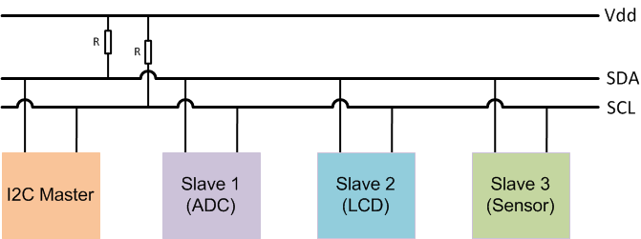
I2C (Inter-Integrated Circuit)
A chip-to-chip protocol for communicating with low-speed peripherals
The I2C bus drivers are open drain, which means the devices can pull the I2C signal line low but cannot drive it high. By default, both the lines are pulled high by pull-up resistors until the bus is accessed by a master device to avoid bus contention.

Slide 29
I2C (Inter-Integrated Circuit)
I2C is another serial protocol for two-wire interface to connect to low-speed devices like Micro-controller, EEPROMs, I/O Interfaces, and other similar devices used in embedded systems.
I2C is a bus for communication between a master (or can be multiple masters) and a single or multiple slave devices.
I2C uses only two wires- SCL (Serial Clock) and SDA (Serial Data).
SCL (Serial Clock): The clock line used to synchronize all data transfers over the I2C bus, the line over which master device(s) generate the clock signal.
SDA (Serial Data): The data line used to transmit the data between devices, the line over which the master and slave devices communicate serial data
Each I2C Slave devices have a 7-bit/10-bit addressing.
The data transfer rate depends on the clock frequency. In the standard mode, the clock frequency is 100-400 kHz with 7 bit addressing and data transfer of 100 kbps.

Slide 30
I2C Addresses
The clock frequencies for the following three modes are with 10-bit addressing:
1 MHz in fast mode I2C
3.4 MHz in high-speed mode
5 MHz in ultra-fast mode
Addresses need to be unique on the bus to determine the slave that were to transmit the data.
The master device needs no address since it generates the clock (using SCL) and addresses individual I2C Slave devices.
The maximum number of Slave devices that can be used while using 7-bit addressing are 112 devices The I2C specification has reserved 2 sets of 8 addresses, 1111XXX and 0000XXX. and the maximum number of Slave devices used in 10-bit addressing are 1008 devices. The remaining 16 are reserved.
Extension to standard mode I2C

Slide 31
Working of I2C in Arduino
The I2C is a half-duplex type of communication. A master device can only read or write data to the slave at a time. All operations are controlled by master device(s).
In I2C data transfer occurs in Message Frames which are then divided into Frames of Data. A message contains the various number of Frames in which one frame contain the address of the slave, and remaining frames for data to be transmitted.
The message includes START/STOP Conditions, READ/WRITE Bits and ACK/NACK (Acknowledgement/No-acknowledgement) Bits between each Data Frame. Working shown below:
Start Condition: The SDA line switches from high to low voltage level before SCL switches from high to low.
Stop Condition: The SDA line switches from low to high voltage level after SCL switches from low to high.

Slide 32
Working of I2C in Arduino
Address Frame: 7 or 10-bit sequence unique to each slave that identifies the slave when the master wants to talk.
Read/Write Bit: A bit specifying whether the master is sending data to the slave or requesting data from it.
ACK/NACK Bit: Each frame in a message follows an ACK/NACK Bit.
7-bit Addressing:
In 7-bit addressing procedure, the slave address is transferred in the first byte after the Start condition. The first seven bits of the byte comprise the slave address. The eighth bit is the read/write flag where 0 indicates a write and 1 indicates a read.

Slide 33

Working of I2C in Arduino
Figure 1: 7-bit addressing. The I2C bus specification specifies that in standard-mode I2C, the slave address is 7-bits long followed by the read/write bit.
All I2C products from Total Phase, follow this standard convention. The slave address used should only be the top seven bits. In the case of the Aardvark I2C/SPI Host Adapter, the software will automatically append the correct read/write bit depending on the transaction to be performed. In the case of the Beagle I2C/SPI Protocol Analyzer, the slave address and the type of transaction are displayed in two different columns.
Reserved Addresses
The I2C specification has reserved two sets of eight addresses, 1111XXX and 0000XXX. These addresses are used for special purposes.

Slide 34
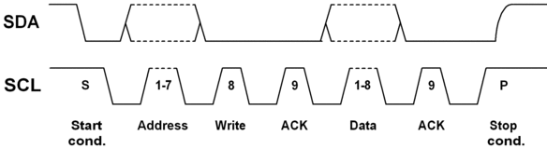
Working of I2C in Arduino
Figure 1: 7-bit addressing. The I2C bus specification specifies that in standard-mode I2C, the slave address is 7-bits long followed by the read/write bit.
The first byte of an I2C transfer contains the slave address and the data direction.
The address is 7 bits long, followed by the direction bit (read or write operation). Like all data bytes, the address is transferred with the most significant bit first.

Slide 35
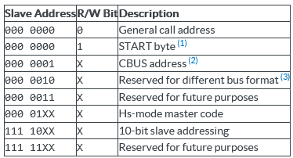
Working of I2C in Arduino
The following table has been taken from the I2C Specifications (2000).
(1) No device is allowed to acknowledge at the reception of the START byte.
(2) The CBUS address has been reserved to enable the inter-mixing of CBUS compatible and I2C-bus compatible devices in the same system. I2C-bus compatible devices are not allowed to respond on reception of this address.
(3) The address reserved for a different bus format is included to enable I2C and other protocols to be mixed. Only I2C-bus compatible devices that can work with such formats and protocols are allowed to respond to this address.

Slide 36

Working of I2C in Arduino
10-bit Addressing
One of the reasons that Total Phase decided to use 7-bit addressing for all of its products was to ensure that 10-bit addressing could be properly handled.
10-bit addressing was designed to be compatible with 7-bit addressing, allowing developers to mix two types of devices on a single bus. When communicating with a 10-bit addressed device, the special reserved address is used to indicate that 10-bit addressing is being used.
Figure 2: 10-bit addressing. In 10-bit addressing, the slave address is sent in the first two bytes. The first byte begins with the special reserved address of 1111 0XX which indicates that 10-bit addressing is being used. The 10 bits of the address is encoded in the last 2 bits of the first byte and the entire 8 bits of the second byte. The 8th bit of the first byte remains the read/write flag.

Slide 37
Program for I2C: I2C_SCANNER
#include <Wire.h>
void setup()
{
Wire.begin();
serial.begin(9600);
while (!Serial); // Leonardo: wait for serial monitor
serial.println("\nI2C Scanner");
}
void loop()
{
byte error, address;
int nDevices;
serial.println("Scanning...");
nDevices = 0;
for(address = 1; address < 127; address++ )
{
// The i2c_scanner uses the return value of the
// Write.endTransmission to see if a device did acknowledge to
// the address.
Wire.beginTransmission(address);
error = Wire.endTransmission();
if (error == 0)
{
serial.print("I2C device found at address 0x");
if (address<16)
serial.print("0");
serial.print(address ,HEX);
serial.println(" !");
nDevices++;
}

Slide 38
Program for I2C: I2C_SCANNER
else if (error==4)
{
serial.print("Unknown error at address 0x");
if (address<16)
serial.print("0");
serial.print(address,HEX);
serial.println(" !");
}
}
if (nDevices == 0)
serial.println("No I2C devices found\n");
else
serial.println("done\n");
delay(5000); // wait 5 seconds for next scan
}
Find addresses of different I2C devices connected to Arduino
https://playground.arduino.cc/Main/I2cScanner/

Slide 39
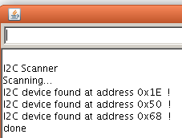
Serial Monitoring
Upload it to the Arduino and open the serial monitor. Every found device on the I2C-bus is reported.
You can change the wires, and plug-in I2C devices while the I2C_scanner is running.
The output of the serial monitor looks like this:

Slide 40
Advantages and Disadvantages of I2C
Advantages
Due to open collector design, limited slew rates can be achieved.
More than one masters can be used in the electronic circuit design.
Needs fewer i.e., only 2 wires for communication.
I2C addressing is simple which does not require any CS lines used in SPI and it is easy to add extra devices on the bus.
It uses open collector bus concept. Hence there is bus voltage flexibility on the interface bus.
Uses flow control.
Disadvantages
Increases complexity of the circuit when number of slaves and masters increases.
I2C interface is half duplex.
Requires software stack to control the protocol and hence it needs some processing overheads on microcontroller/ microprocessor

Slide 41
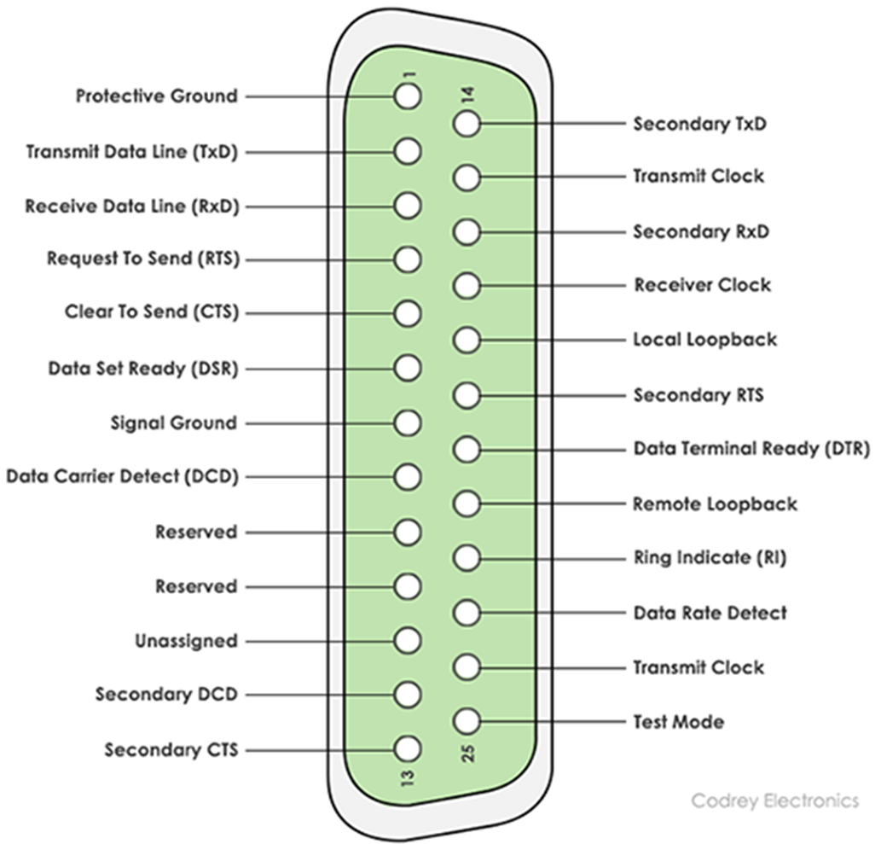
RS232
RS232 is the interface mainly used for serial data communication.
It supports data transfer rate from about 110 bps to about 115200 bps.
Hyper terminal is the application mainly used to check serial communication port of the computer, often referred as COM port.
The interface is of two types-
DB9 pin connector and
DB25 pin connector.
The interface is mainly used for one to one serial communication.
DB25: 25 pin connectors

Slide 42
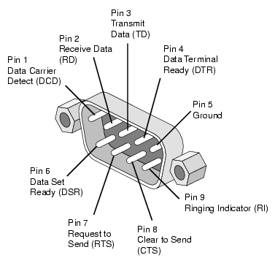
RS232
DB9: 9 pin connectors

Slide 43
Summary
The UART is good for basic, full-duplex data communication between two devices with a similar clock.
An SPI is good for full-duplex, high-speed data communication with two or more peripherals.
An I2C is good for slow-speed data communication with multiple devices, among multiple masters over a 2-wire bus.

Slide 44
Thanks for attending….
?

